Slide 1


LECTURE 01
NT-Ops
Number theory optimizations for competitive programming

Slide 2






COURSE LOGISTICS
Class Schedule
Platform
Resources
The time will be announced on the morning of the class via group. The sessions will be held primarily at night.
Lectures will be taken on Google Meet. The meet link will be shared on the group a few hours before class.
A centralized Drive link containing the lecture slides, assignments, and solution PDFs will be sent in the group.

Slide 3
EXPECTED ENGAGEMENT AND CERTIFICATION
Attendance will be taken in every class via a QR code shared during the class.
Starred assignment questions must be submitted on Codeforces.
Only the Top 80% of participants who complete the evaluations will be ratified.

Slide 4
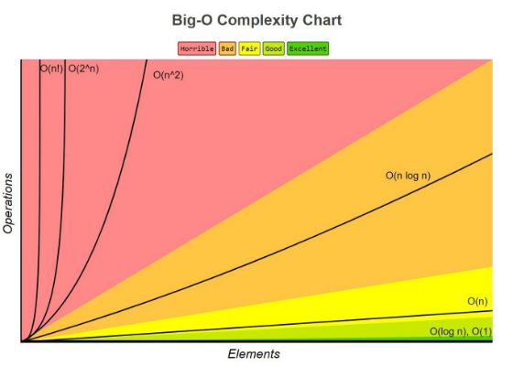
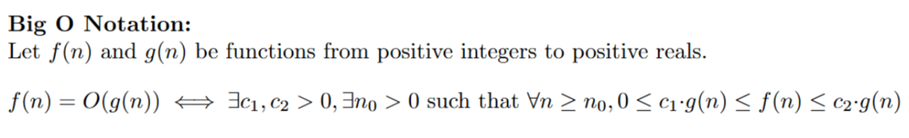
TIME COMPLEXITY & Big O notation

Slide 5
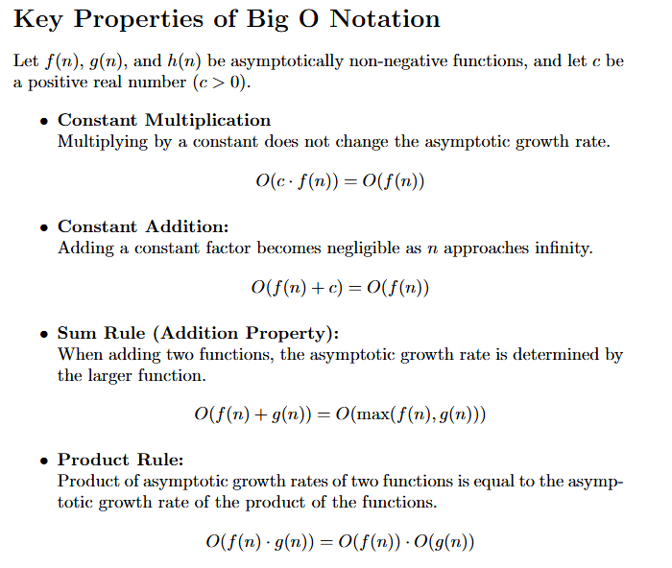
TIME COMPLEXITY & Big O notation

Slide 6




Examples of time complexity:
O(1) - Constant
O(log N)
O(N) - Linear
O(√N)
Divides problem size in each step (e.g., Binary Search).
Processing every element once. The standard for loops.
Essential for Divisor Finding and Primality testing.
Operations independent of input size (e.g., accessing an array index).
Constraint Rule: A typical server handles ~10^8 operations per second.

Slide 7
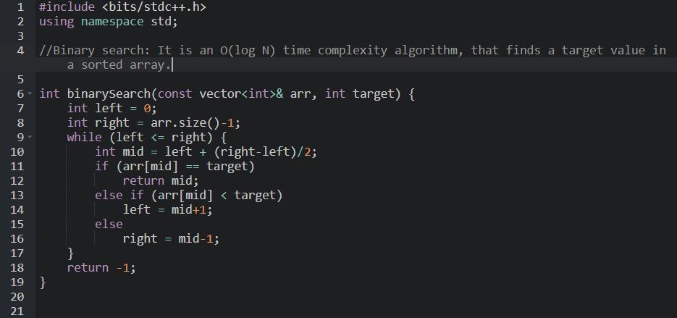
Examples of time complexity: Binary Search O(log N) time complexity

Slide 8
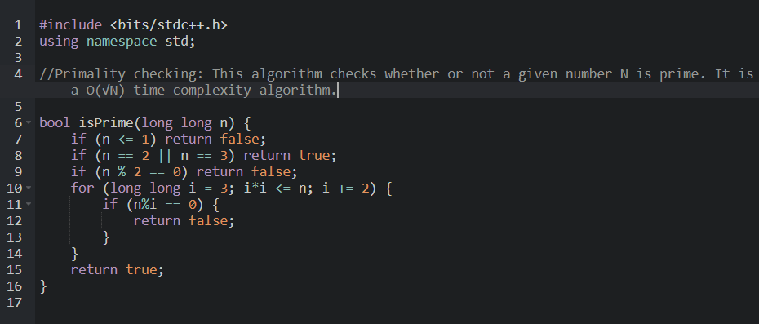
Examples of time complexity: Primality Checking O(log √N) time complexity

Slide 9
INTEGER BOUNDS IN C++
Type | Storage | Approx. Range | Usage Limit
int | 32-bit | -2 × 10^9 to 2 × 10^9 | Up to 10^9 values
long long | 64-bit | -9 × 10^18 to 9 × 10^18 | Massive integers (~10^18)
Danger: 10^9 × 10^9 will OVERFLOW a 32-bit int!

Slide 10
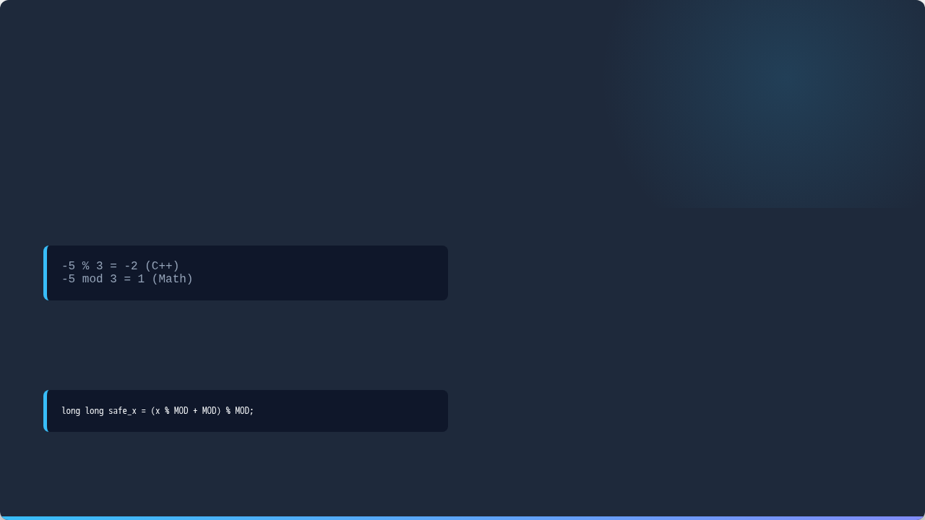

MODULO & NEGATIVES
C++ handles the remainder operator % differently than pure mathematics for negative values.
Why Normalize?
Without normalization, your running sums in problems will corrupt, yielding incorrect negative results.
To normalize to a positive remainder, use the Safe Modulo trick:

Slide 11



MODULAR PROPERTIES
Avoid overflow by taking the modulo at every step of addition and multiplication.
Addition
Subtraction
Multiplication
(A + B) % M = ((A % M) + (B % M)) % M
(A - B) % M = ((A % M) - (B % M) + M) % M
(A * B) % M = ((A % M) * (B % M)) % M
Warning: Division (A / B) % M does NOT exist simply. It requires Modular Inverses!

Slide 12
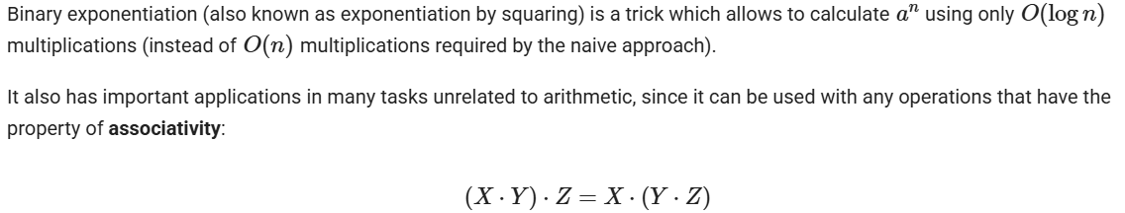
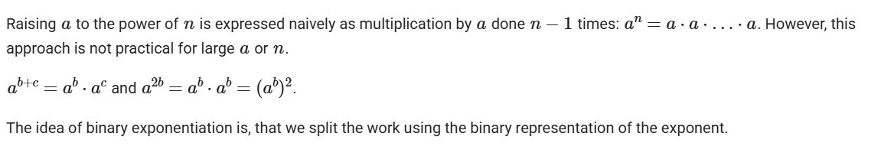
BINARY EXPONENTIATION (Contd.)

Slide 13
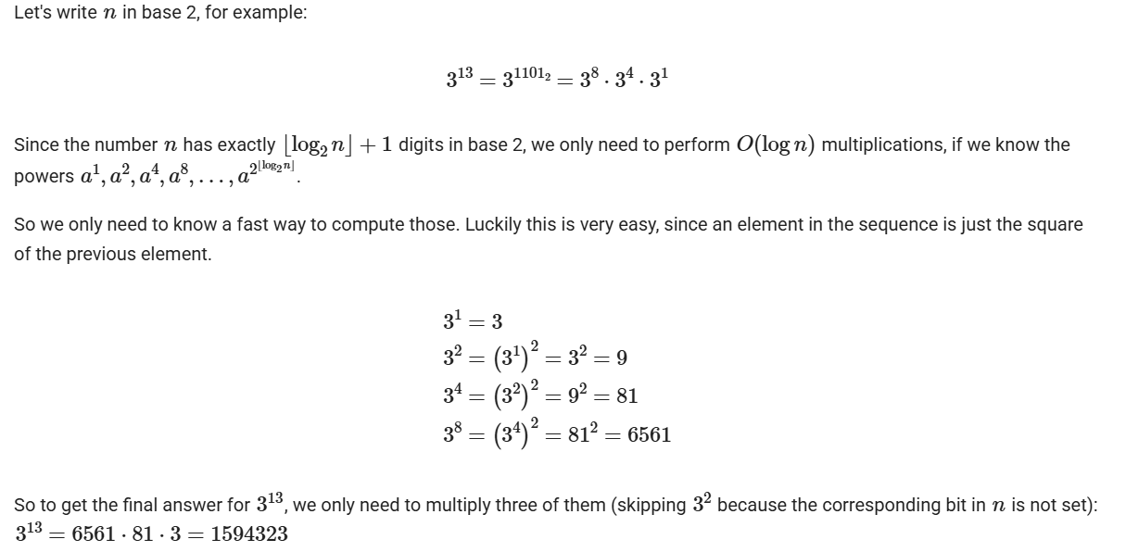
BINARY EXPONENTIATION (Contd.)

Slide 14
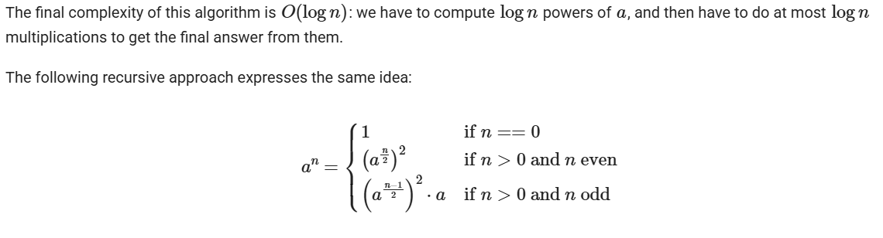
BINARY EXPONENTIATION

Slide 15
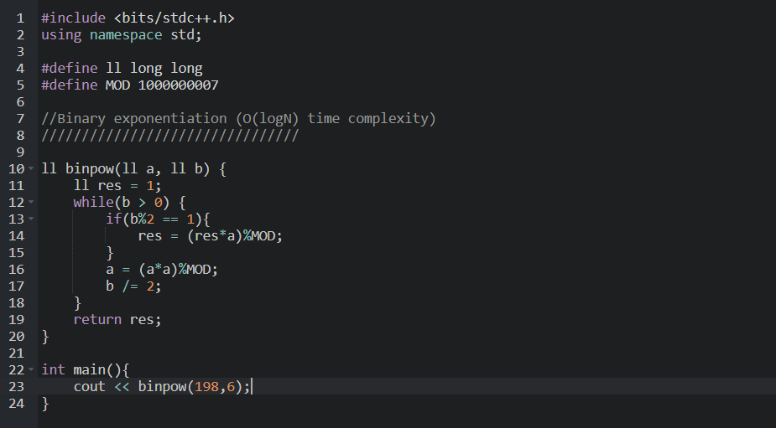
BINARY EXPONENTIATION (IMPLEMENTATION)

